Slide 1
Traffic Sign Information
Machine Learing & Applications
Avlonitis Ektor
Kalogeris Spyros
Kapolis George

Slide 2
Our Steps
Classification
Detection
Demonstration
Built a deep neural network model for traffic sign classification
Used different approaches for traffic sign detection
Implemented these methods to images, videos and real-time

Slide 3
Dataset Infographics
43
6 – 74
30
>50K
Number of traffic signs
Varying dataset – Different images per sign
Number of different sizes per image
Number of training data from Kaggle
Resizing
Resized Dataset
70
Increases the dataset size
The resized images vary from 30x30 to 144x144
40
10
No. of traffic signs
No. of sizes per image
Min no. of images per sign
Max no. of images per sign

Slide 4




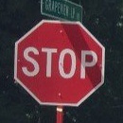





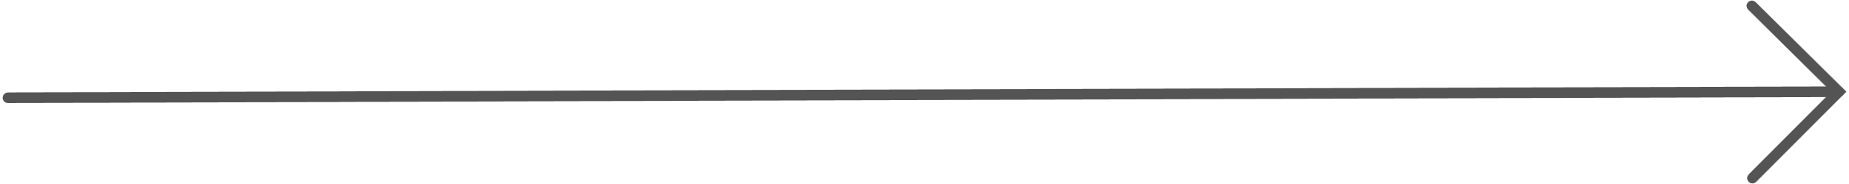
Our Convolution Neural Network
Conv
3x3 kernel
1 padding
Conv
3x3 kernel
1 padding
Flatten
Conv
5x5 kernel
2 padding
Conv
5x5 kernel
2 padding
Max Pool
2x2 kernel
Fully Connected Layer
Max Pool
2x2 kernel
64x64
32x32
16x16
64x64
64x64
32x32
32x32
Transformation
Why?
64x64 transformation applied to the training data and the input image
Accuracy and computational efficiency

Slide 5
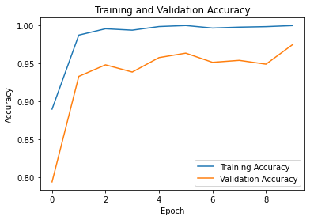
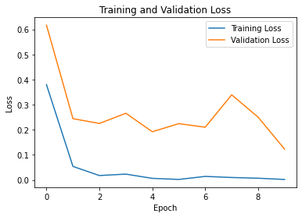
CNN with 20 Traffic Signs
Training and Validation Accuracy
Training and Validation Loss
Validation Accuracy
Validation Loss decreases
97.46%
The model does not overfit!

Slide 6
Brute Force Approach
Sliding Window
Scan the image systematically for the presence of objects
CNN model
A pre-trained CNN model was used for traffic sign classification
Bounding Boxes
Bounding boxes were drawn around the detected objects with their probabilities
Drawbacks
Inefficiency, missed detections, and computationally expensive for videos

Slide 7
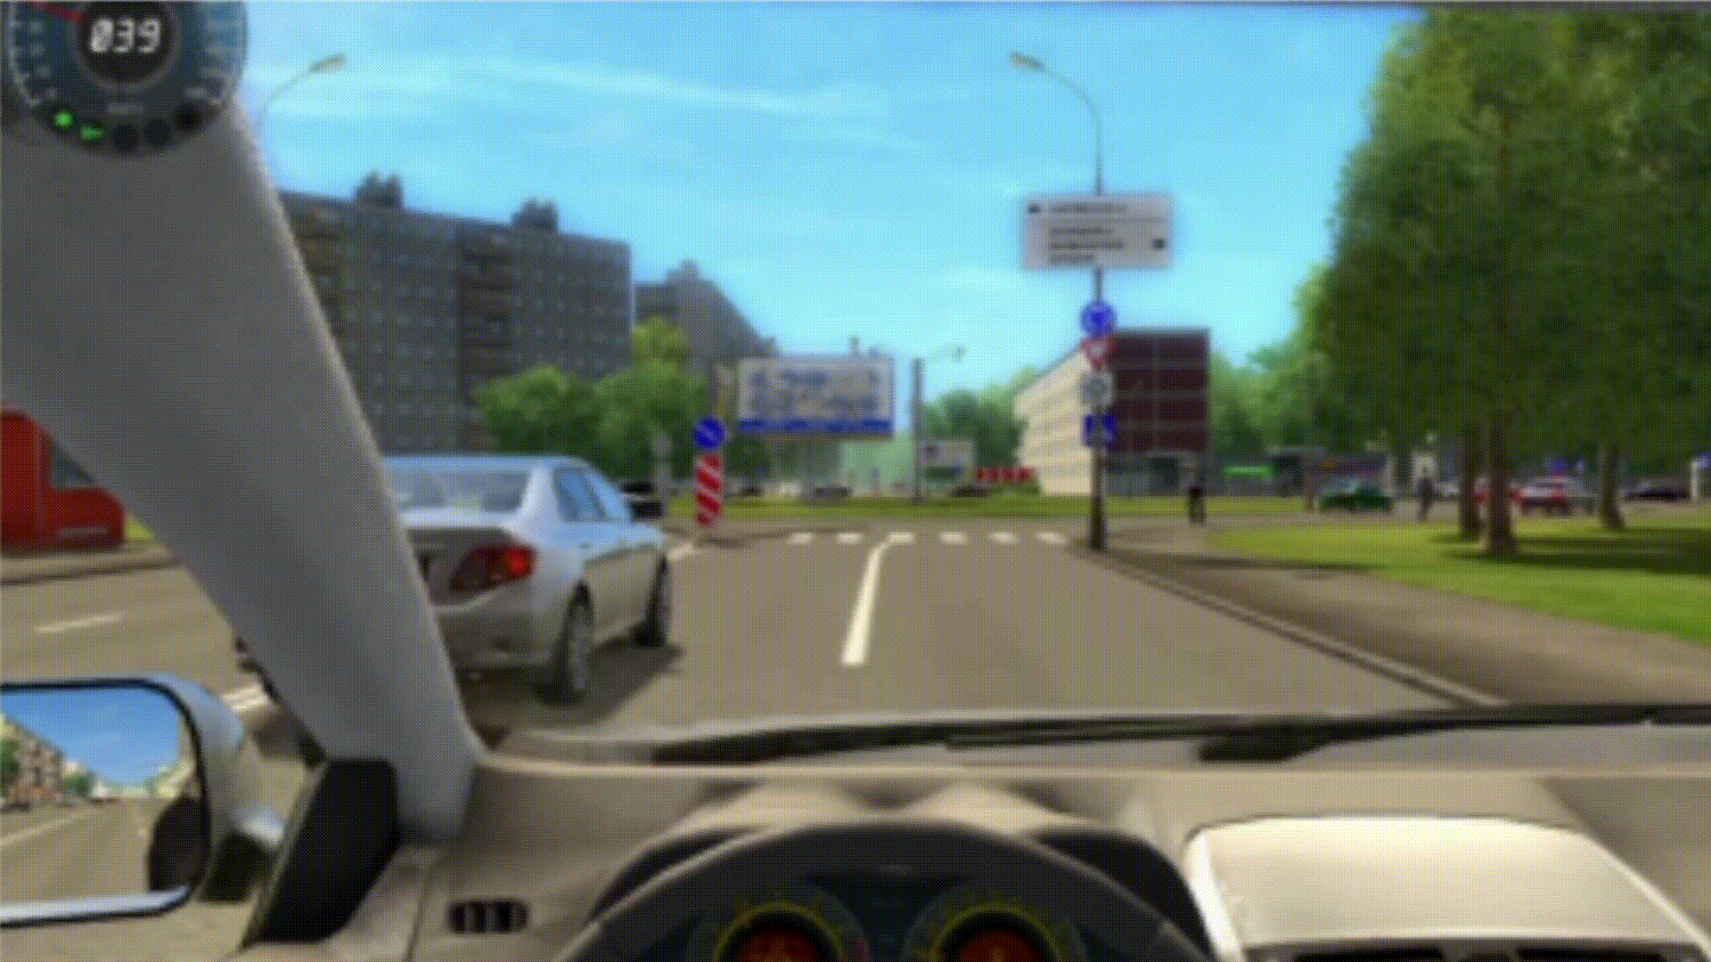
Object detection using the brute force approach
Video
High-quality simulated video was used
Process
Frames were displayed one after the other while the screen was recording
The playback speed of the recorded video was increased to simulate real-time detection

Slide 8
Selective Search Approach
Segmenting the Image
The Felzenszwalb algorithm is used based on some criteria
Proposals
These proposals are merged → large regions
Similarity Measure
Intersection over Union is used for merging → high similarity are merged
Final proposals
Area threshold used → remove small regions

Slide 9
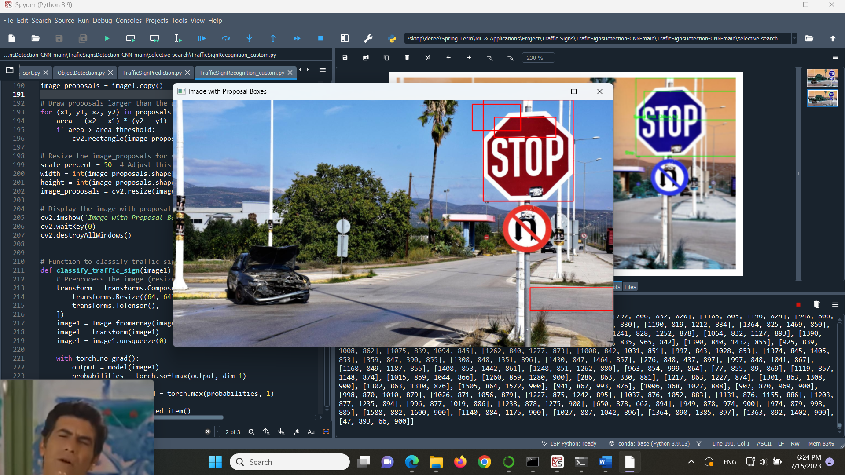
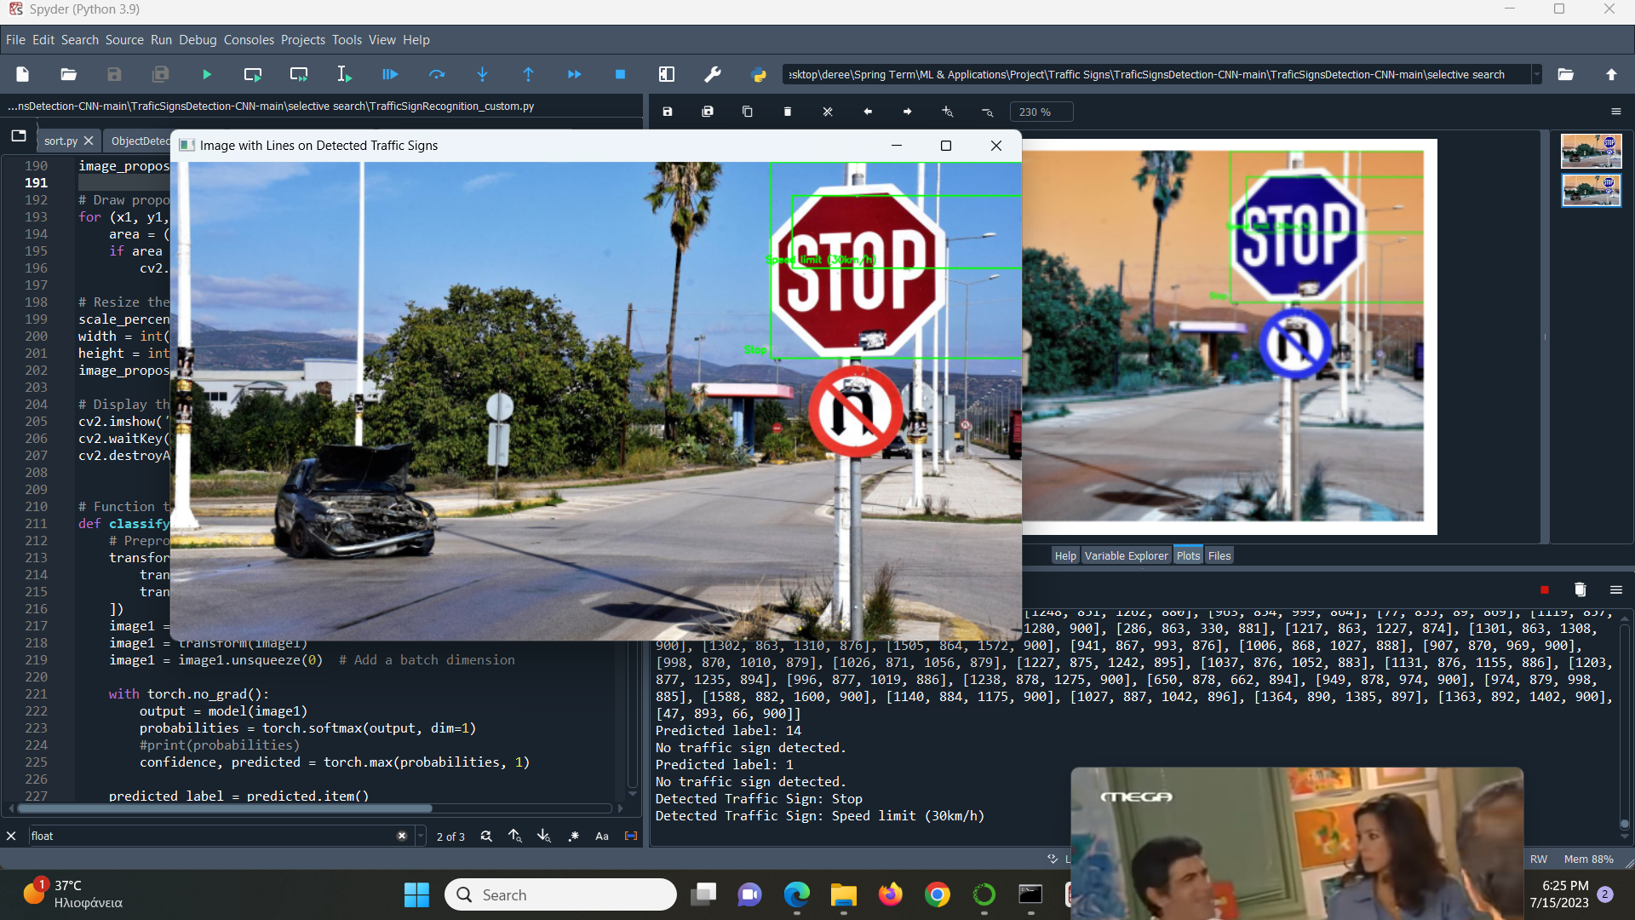
Object detection using the selective search approach
Image
Process
CNN is used for classification
False Positives are observed
Optimize:
Confidence threshold
Area threshold

Slide 10

Yolov8
YOLO Train
(YOLOv8m)
Data
preparation
Sign detection & classification
TRAINED CNN

Slide 11
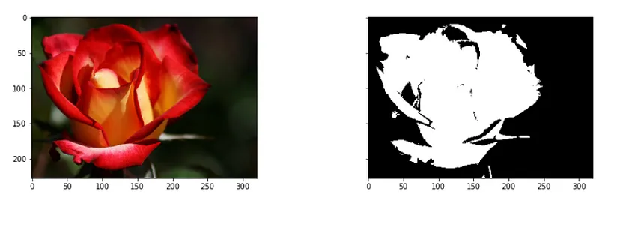
Future Work – Binary thresholding
Binary Image
Apply a threshold. Above → 1 (White). Below → 0 (Black)
Machine Vision Techniques
Erosion, dilation, opening, closing → better detection
CNN
Train the model → different dataset (sign + background)
Labels
Coordinates of the objects of interest

